Slide 1
TA contest info 6250 (PSA)
Lesson 1 : Divide and Conquer Algorithm
Yash Bhatia (002791499)

Slide 2
Divide and Conquer Algorithm
There always lies a strategy to solve a problem. Divide and conquer is one of those strategies of solving a problem by
Divide: Breaking the problem into smaller parts using recursion
Conquer: Solving those smaller parts recursively and if the part is small enough, solve it directly and
Combine: Combining the smaller parts to get the desired output.

Slide 3
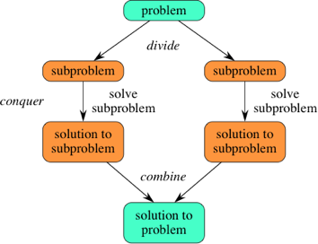

Slide 4
Advantages of Divide and Conquer:
Efficiency
Parallelism
Code Reusability
Optimal Substructure
Simplicity

Slide 5
Disadvantages of Divide and Conquer:
Overhead
Not Always Applicable
Complexity
Base Case Design
Memory Usage
Algorithmic Dependency

Slide 6
Binary Search

Slide 7
Binary Search
Binary Search repeatedly divides a sorted array in half and compares the middle element to the target value, effectively eliminating half of the remaining search space in each step.
The data structure must be sorted.
Any element should be accessed in constant time.

Slide 8
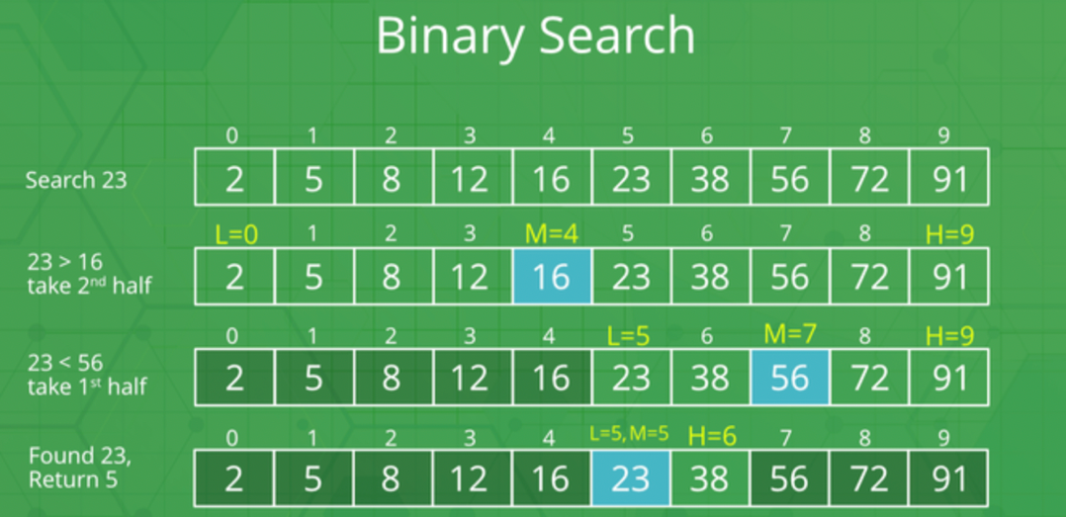

Slide 9
2 methods can be used to implement binary search:
Iterative Binary Search Algorithm
Recursive Binary Search Algorithm

Slide 10
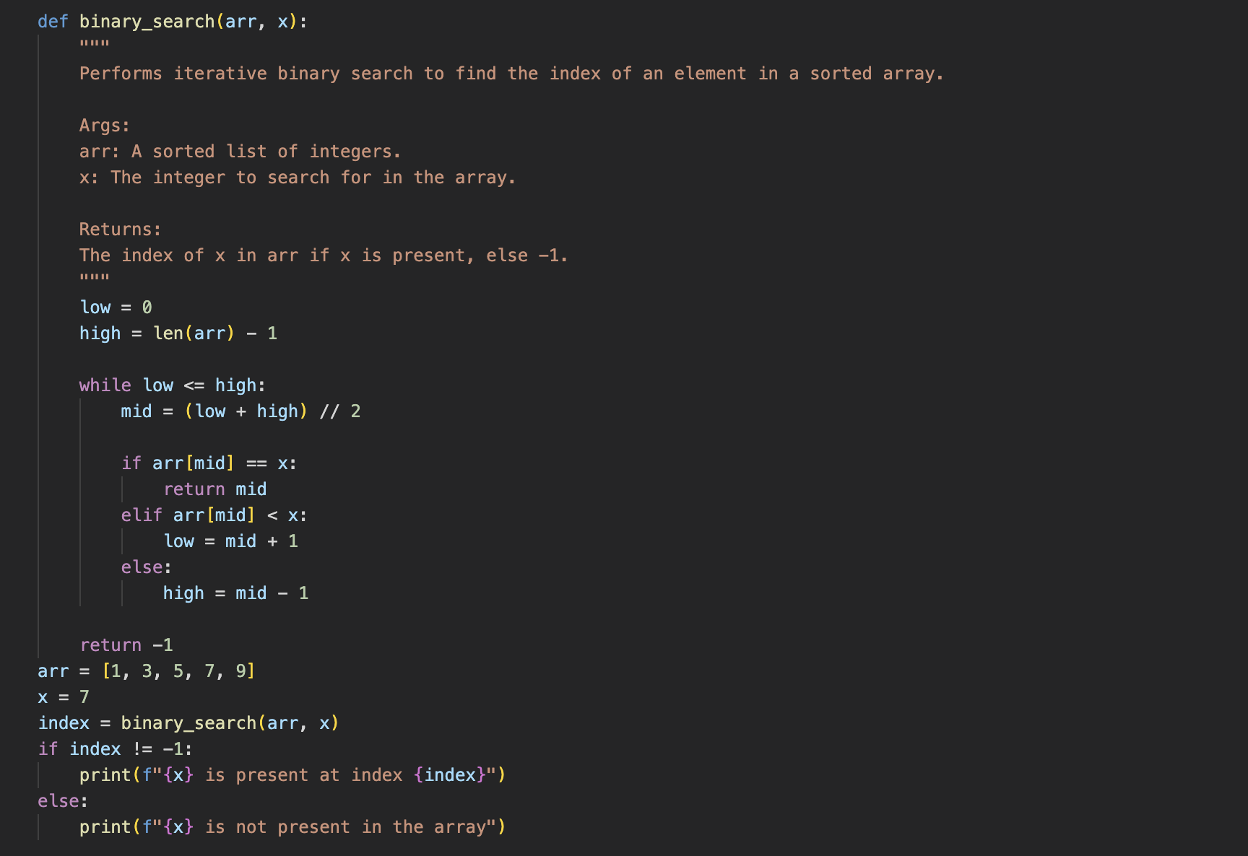

Slide 11
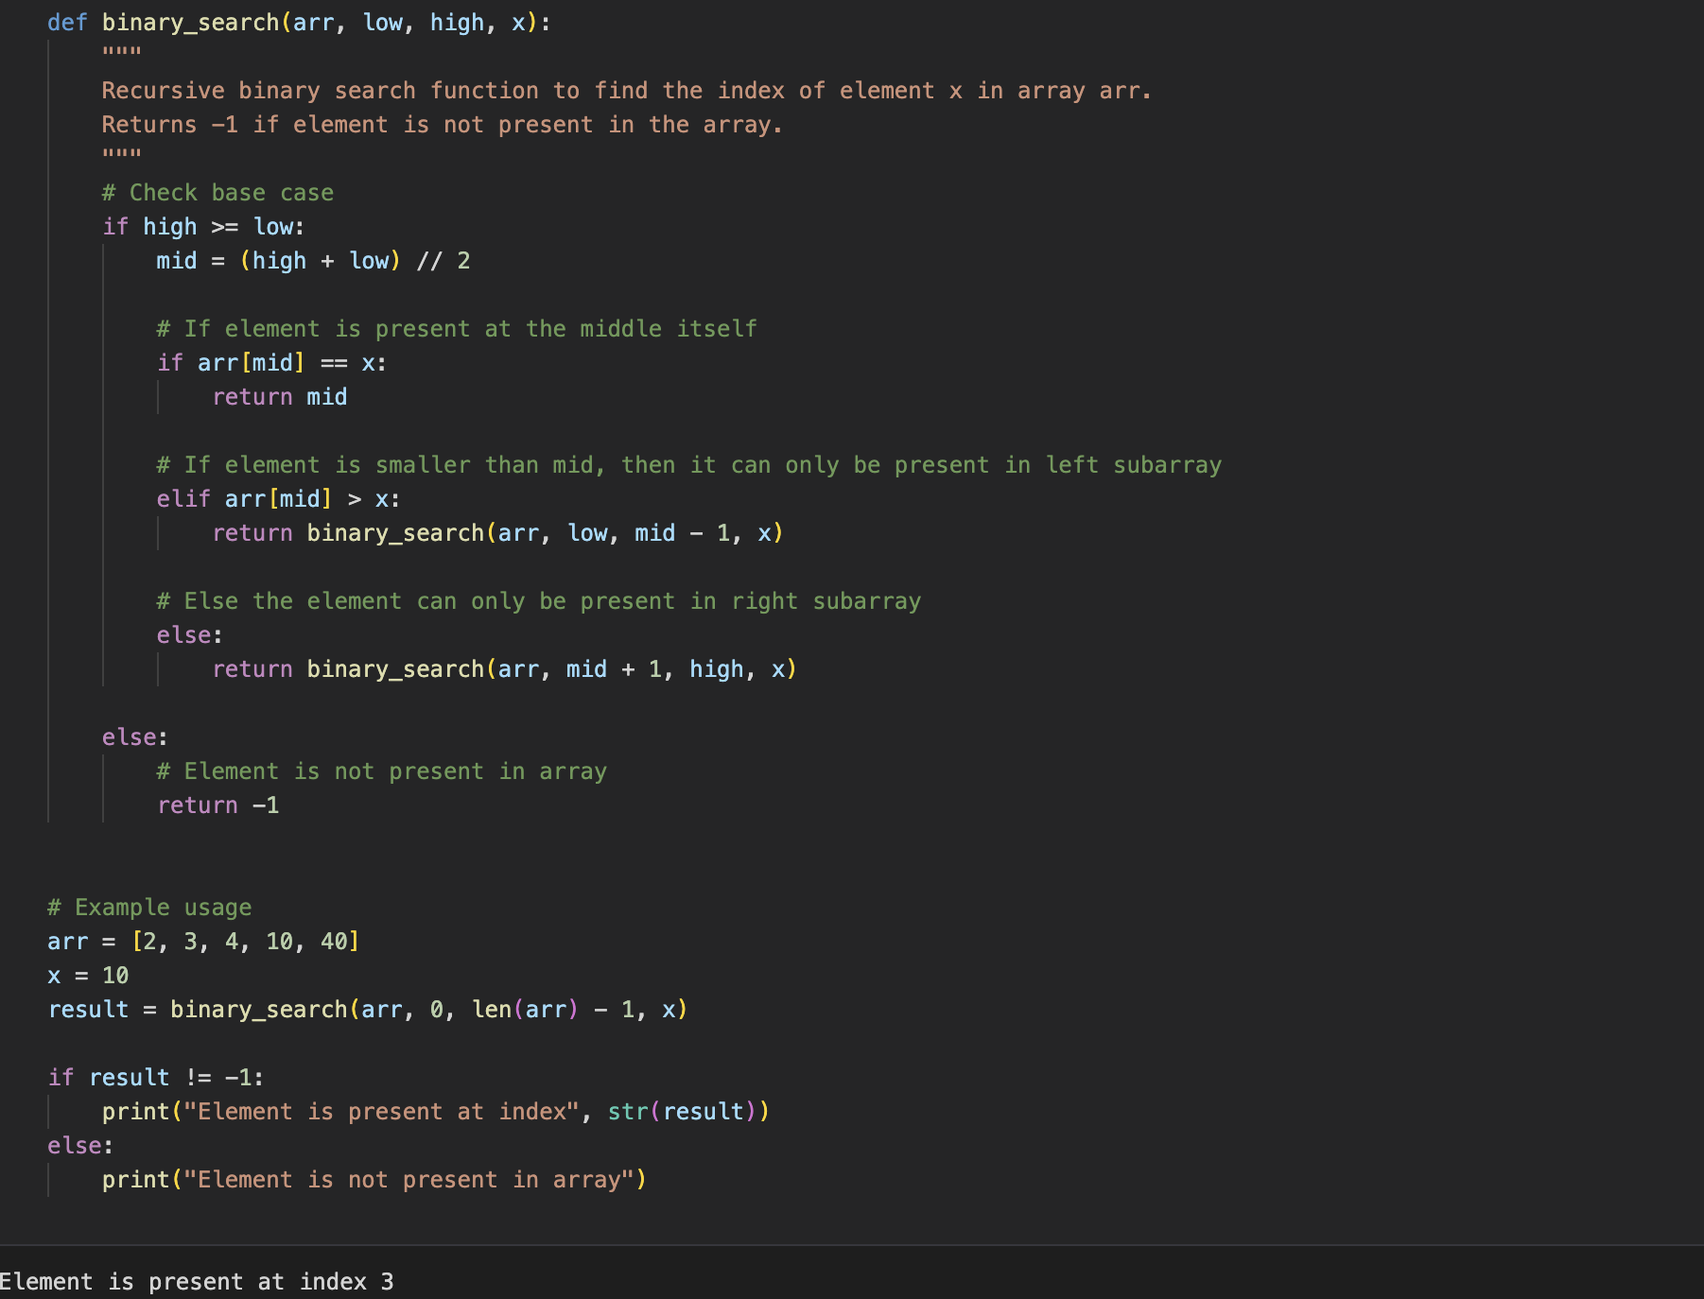

Slide 12
Merge Sort

Slide 13
Merge Sort
Merge Sort follows a simple and efficient approach to divide the input array into smaller subarrays, sort those subarrays, and then merge them back together to obtain a sorted output.
Basic Steps:
Divide: The input array is divided into two halves until each subarray contains a single element or is empty.
Conquer: The subarrays are recursively sorted using Merge Sort.
Merge: The sorted subarrays are merged back together to create a single sorted array.

Slide 14
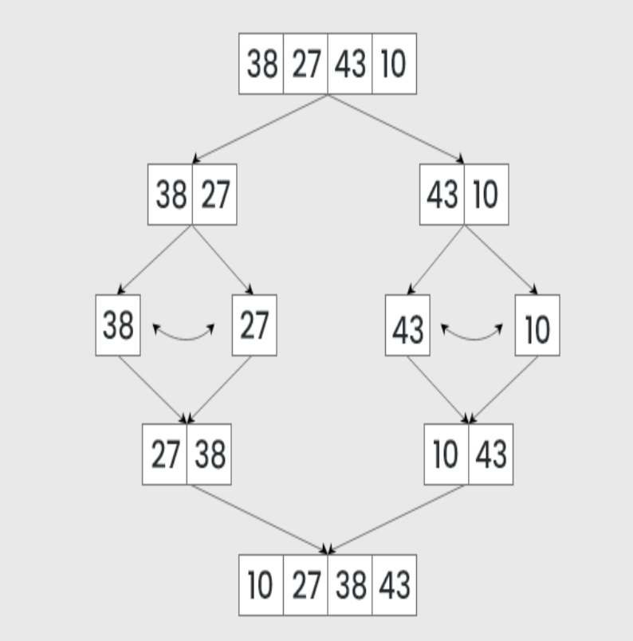

Slide 15
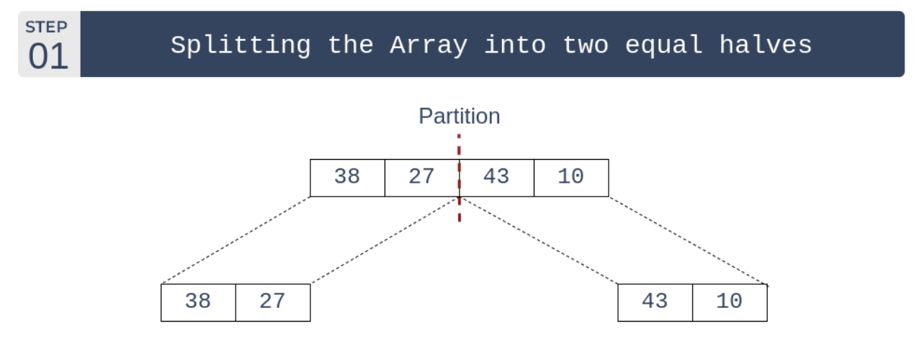

Slide 16
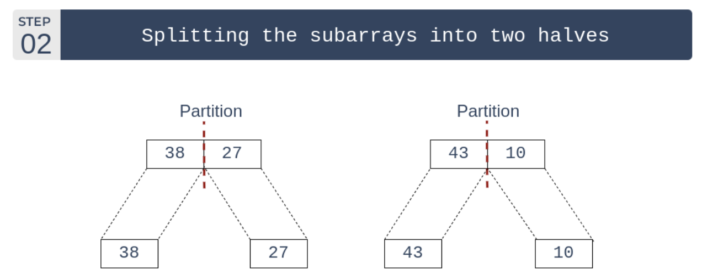

Slide 17
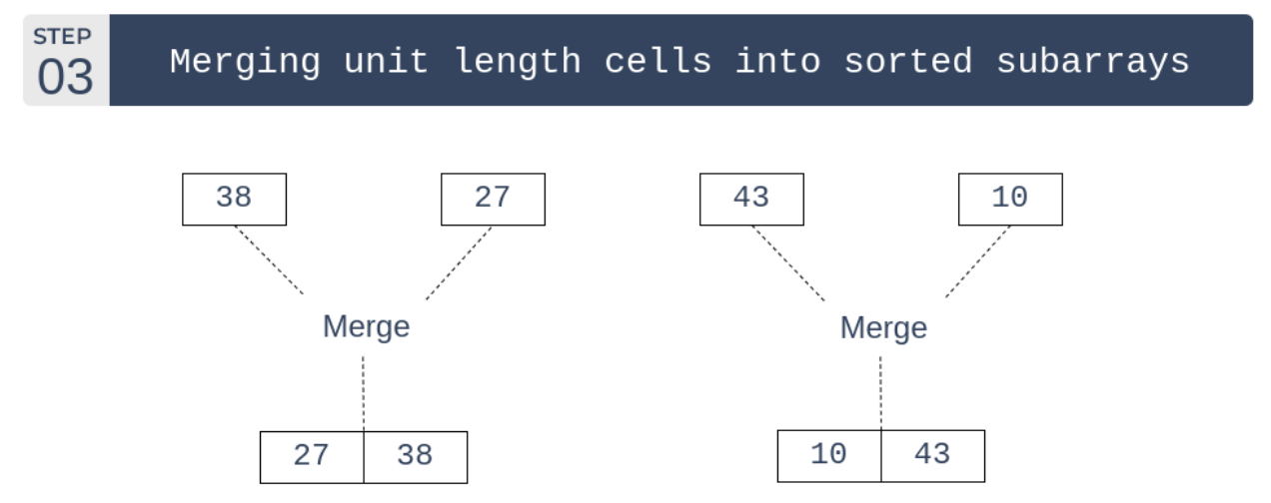

Slide 18
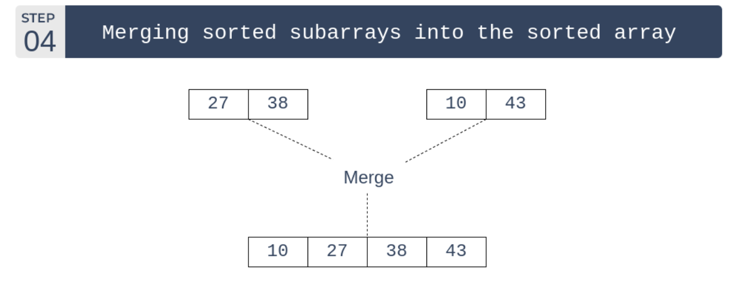

Slide 19
Time and Space Complexity Analysis:
Time Complexity: Merge Sort has a time complexity of O(n log n) in all cases, where n is the number of elements in the input array.
Space Complexity: Merge Sort has a space complexity of O(n), as it requires temporary storage space for the subarrays during the recursion.

Slide 20
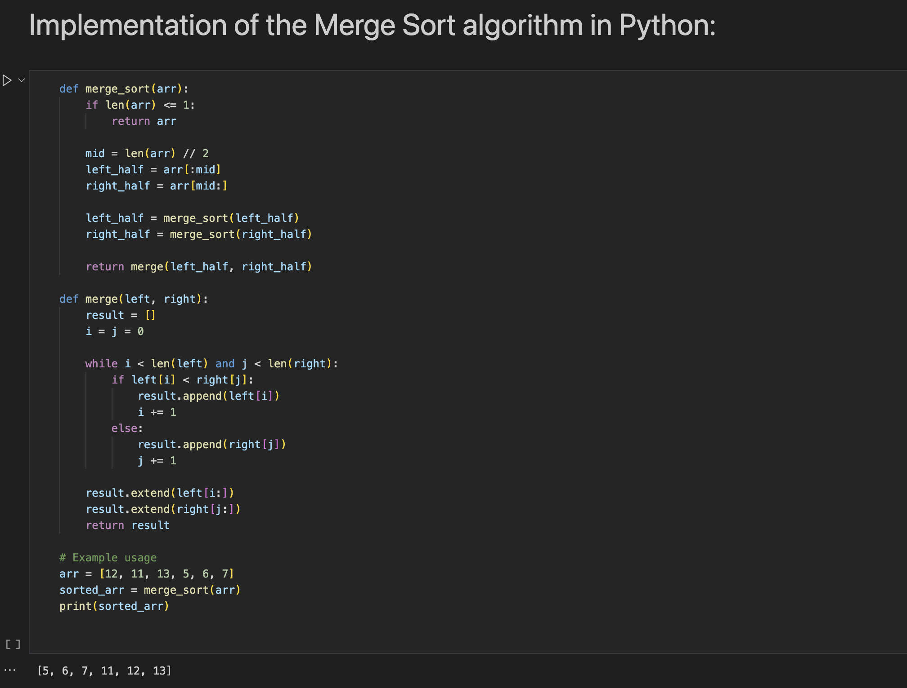

Slide 21
Quick Sort

Slide 22
Quick Sort
It works by selecting a pivot element from the array, partitioning the other elements into two subarrays based on whether they are less than or greater than the pivot, and then recursively sorting these subarrays.
Basic Steps:
Choose a Pivot
Partitioning
Recursion
Combine

Slide 23
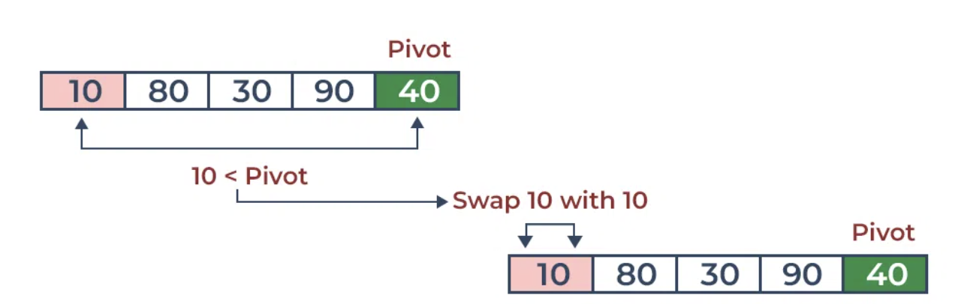

Slide 24
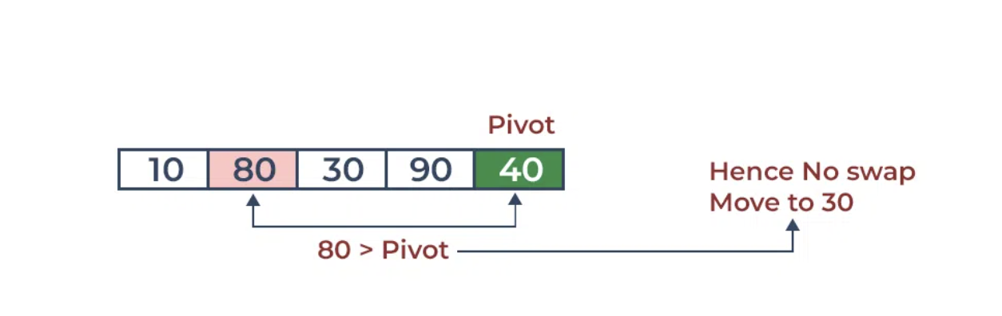

Slide 25
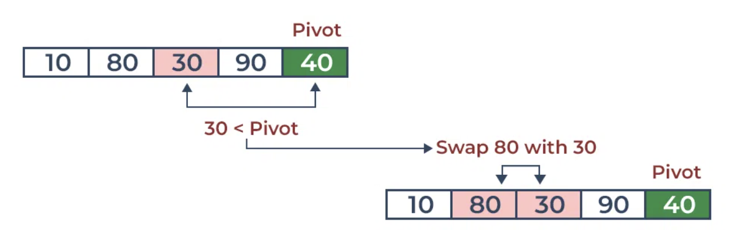

Slide 26
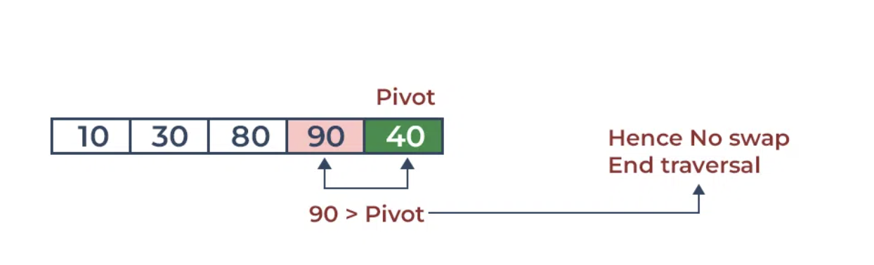

Slide 27
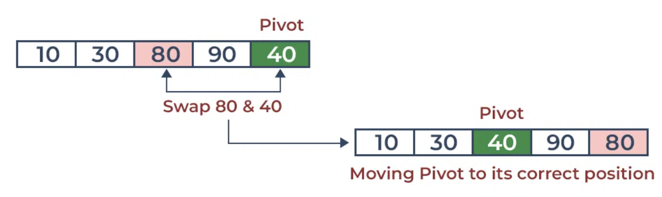

Slide 28
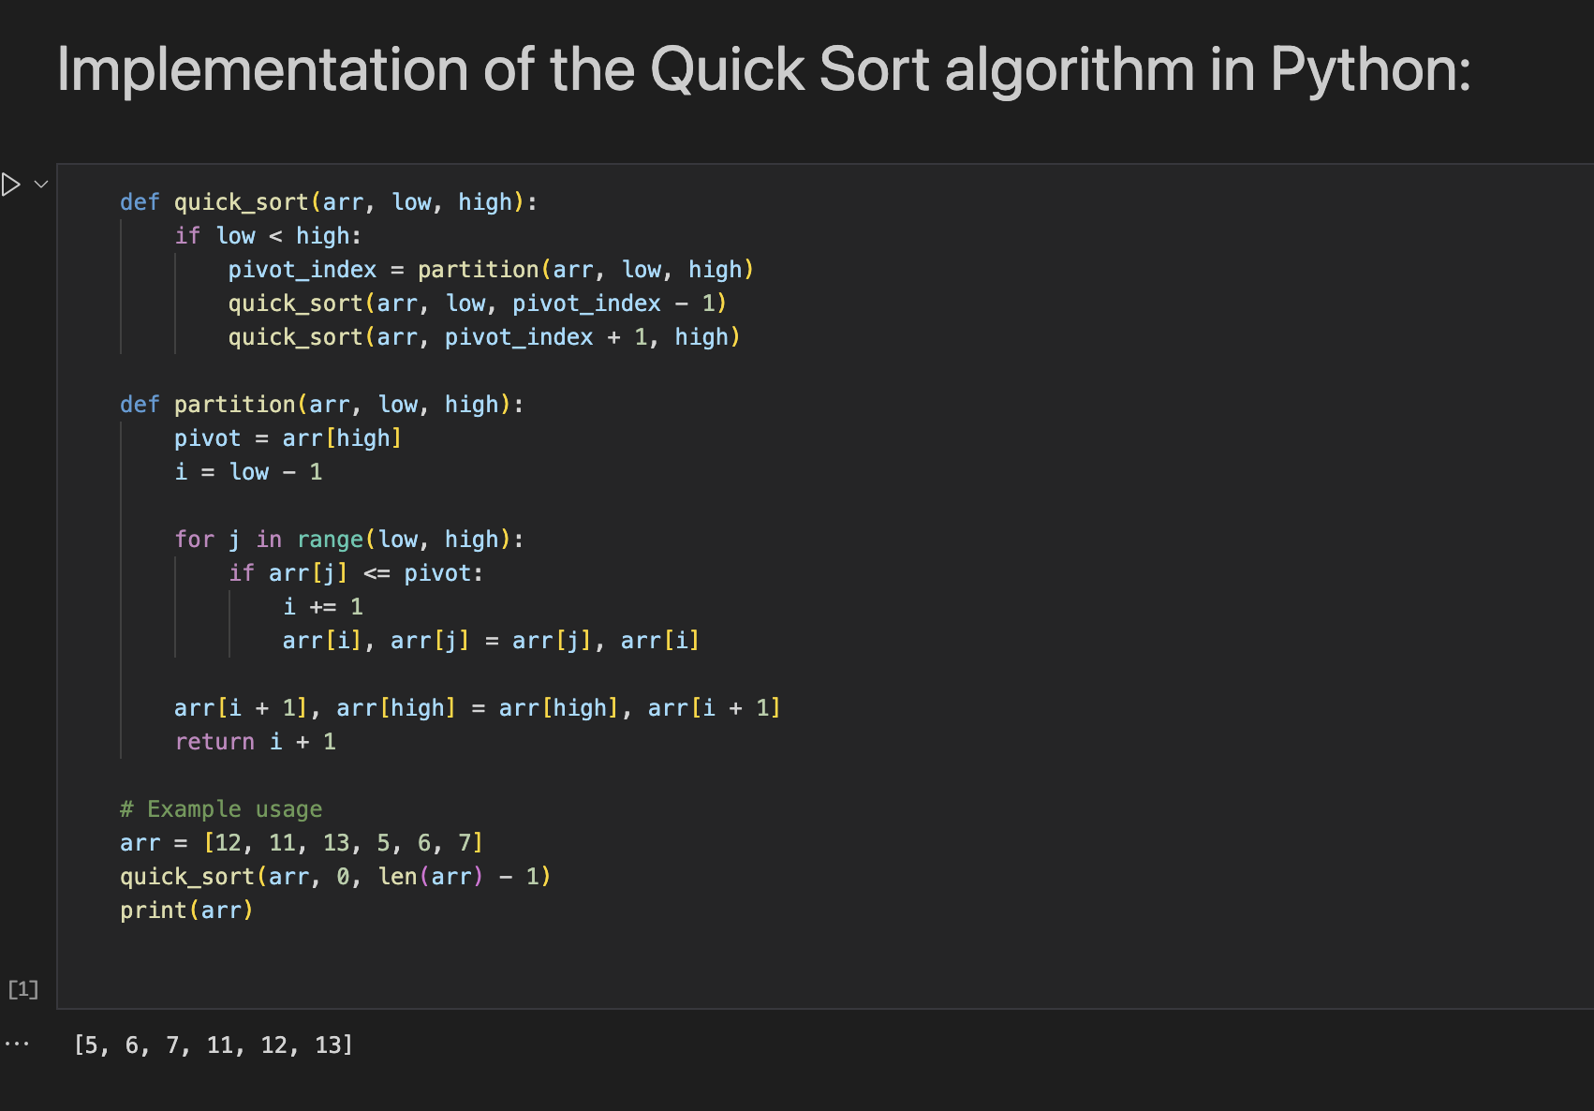

Slide 29
Time and Space Complexity Analysis:
1. Time Complexity: The average-case time complexity of Quick Sort is O(n log n), where n is the number of elements in the input array. In the worst case (when the pivot selection is unfavorable), the time complexity can degrade to O(n^2), although good pivot selection techniques and randomization can mitigate this. On average, Quick Sort is faster than many other sorting algorithms.
2. Space Complexity: Quick Sort has a space complexity of O(log n) due to the recursive call stack. In the best case, the space complexity can be O(log n), while in the worst case, it can be O(n).

Slide 30
Thank You

